Slide 1
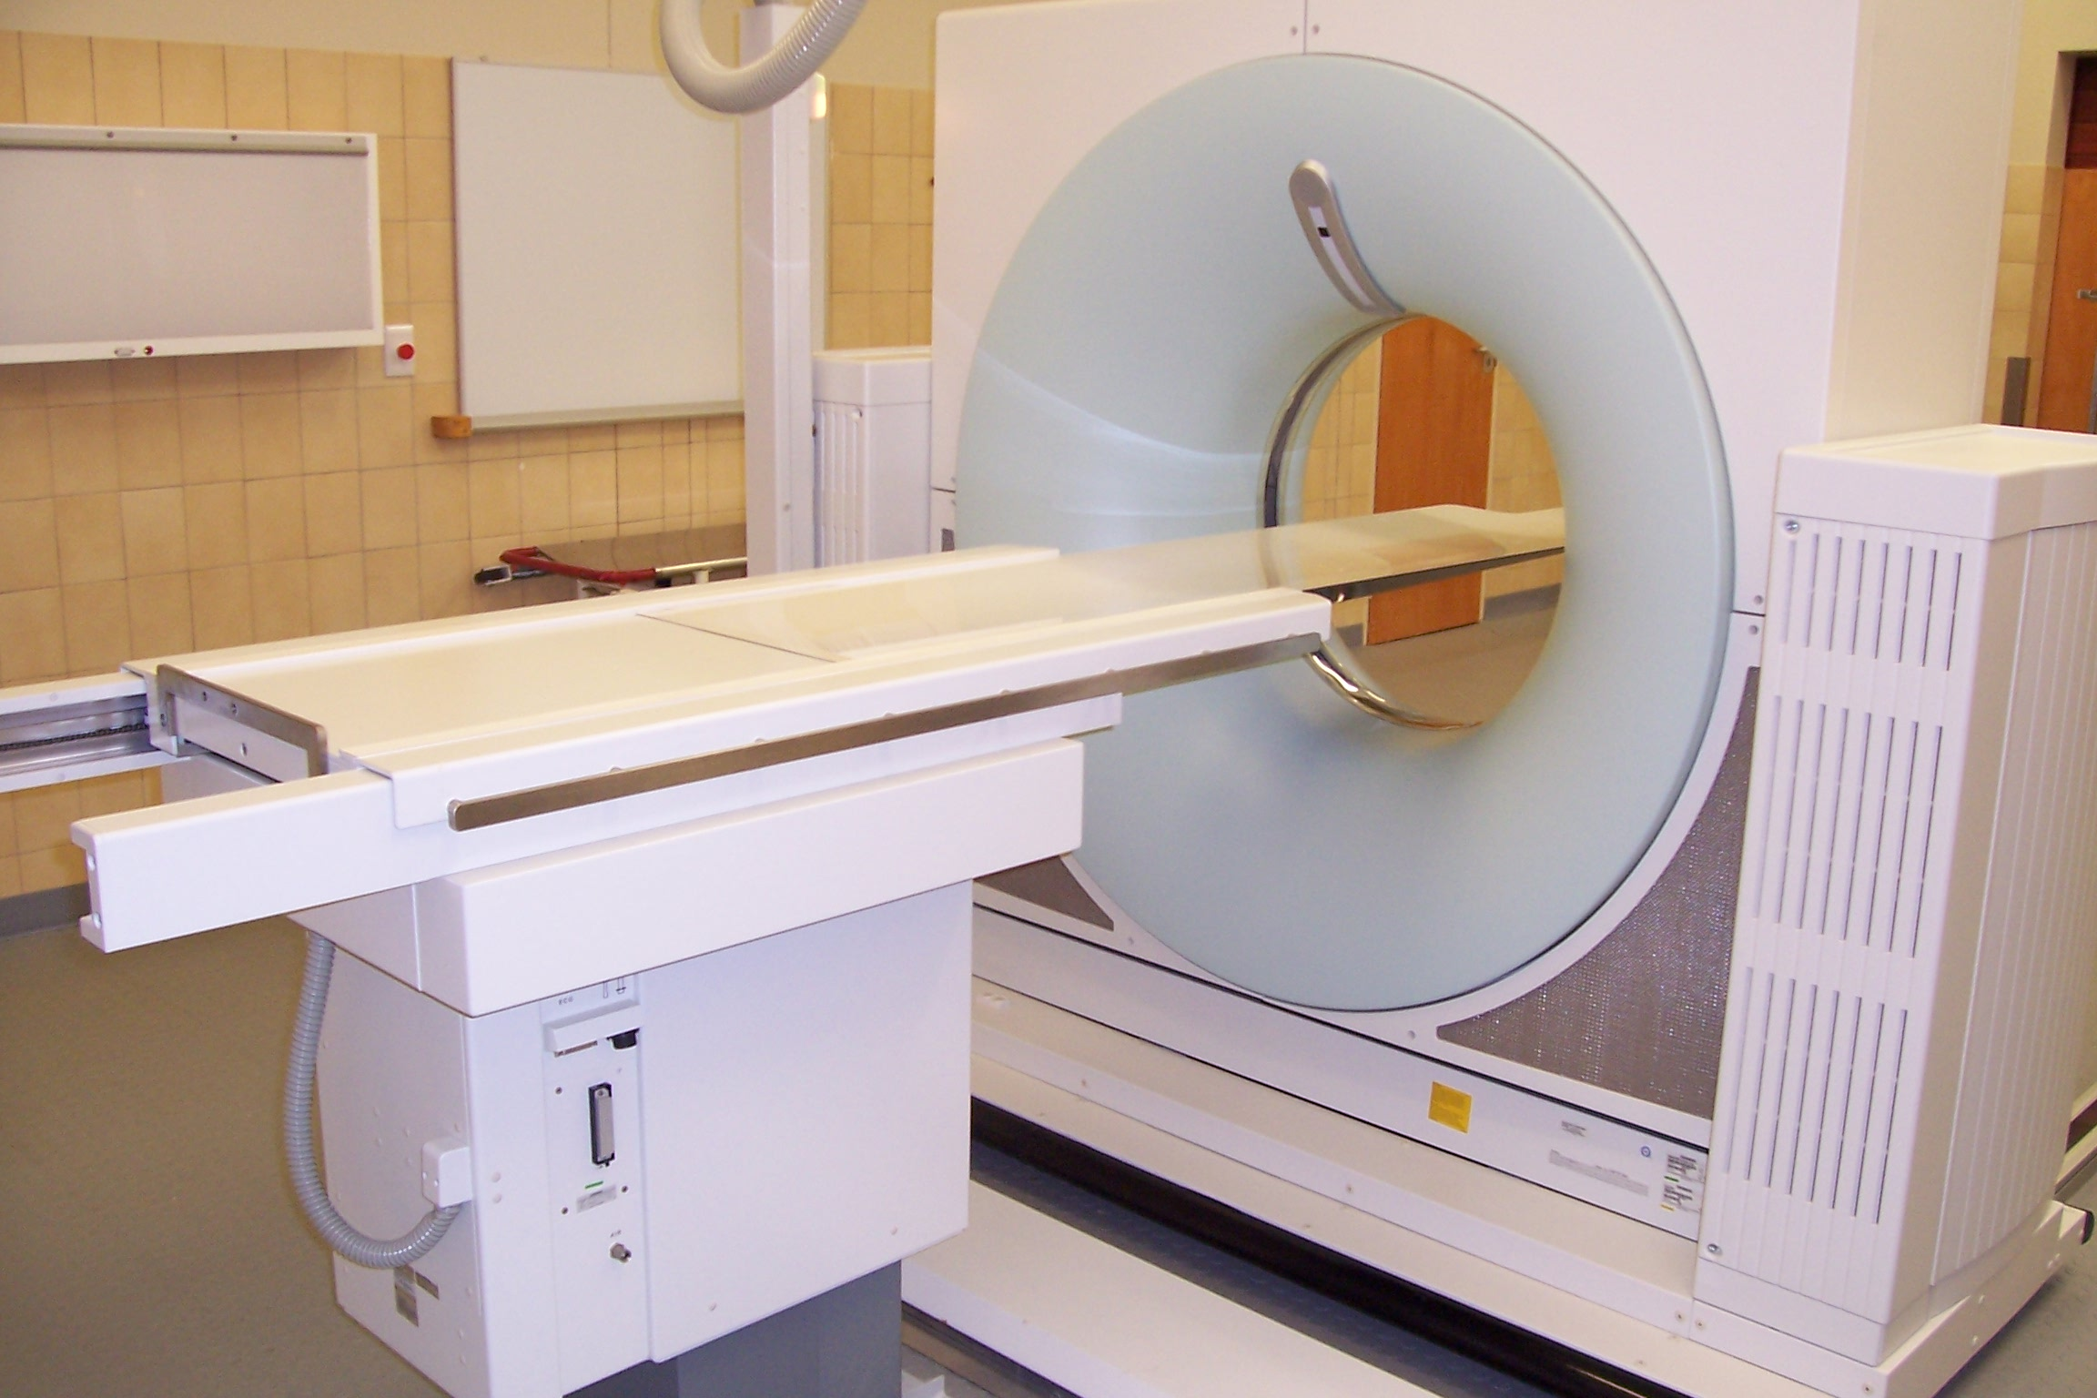
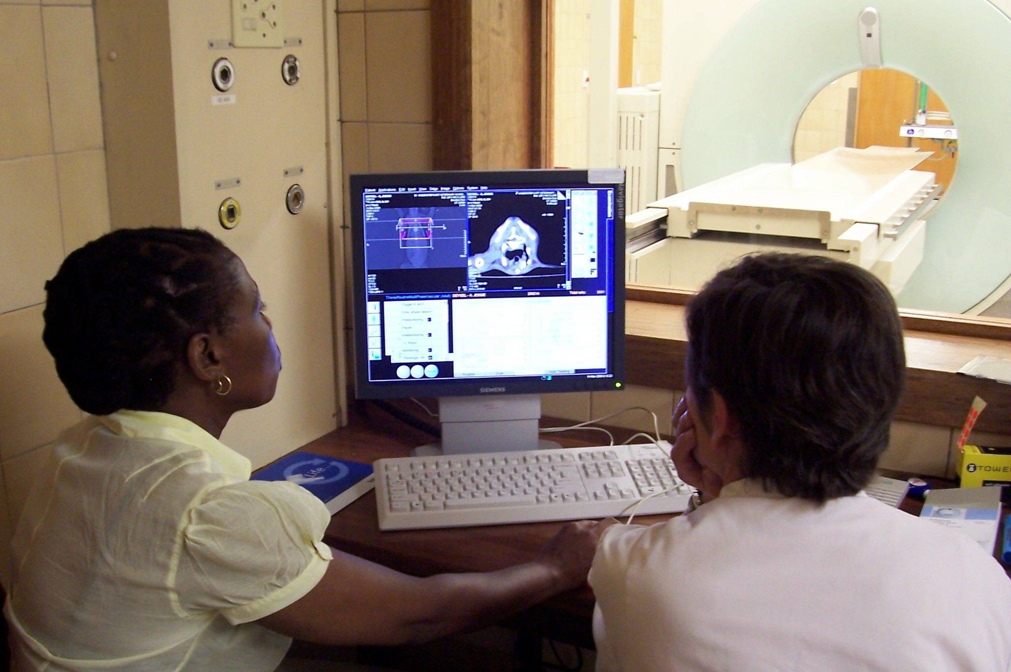
Computed Tomography
Synonyms – CT scan; Computerized Tomography; Computerized axial tomography (CAT) scan.
Definition of CT- A procedure that uses a computer linked to an x-ray machine to make a series of detailed pictures of areas inside the body. The pictures are taken from different angles and are used to create 3-dimensional (3-D) views of tissues and organs

Slide 2
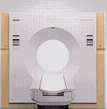
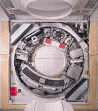
1
2
b) Inside view of the CT system
a) Outside view of CT system
1- X-ray tube
2 – X-ray detector

Slide 3
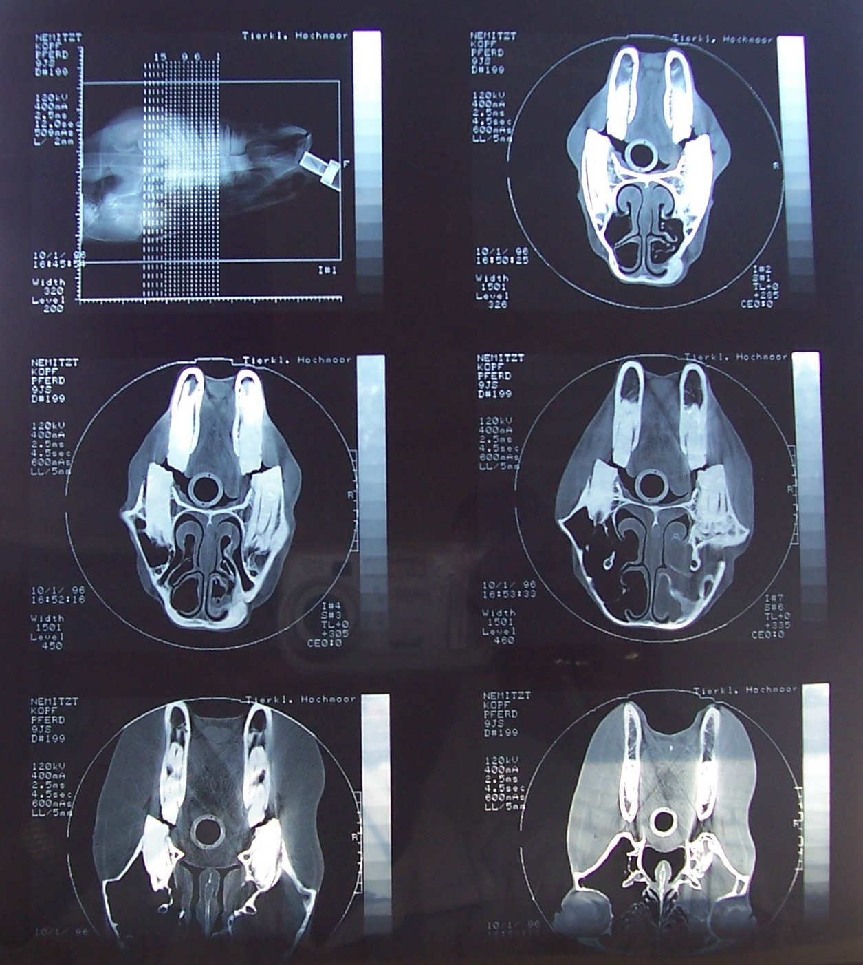
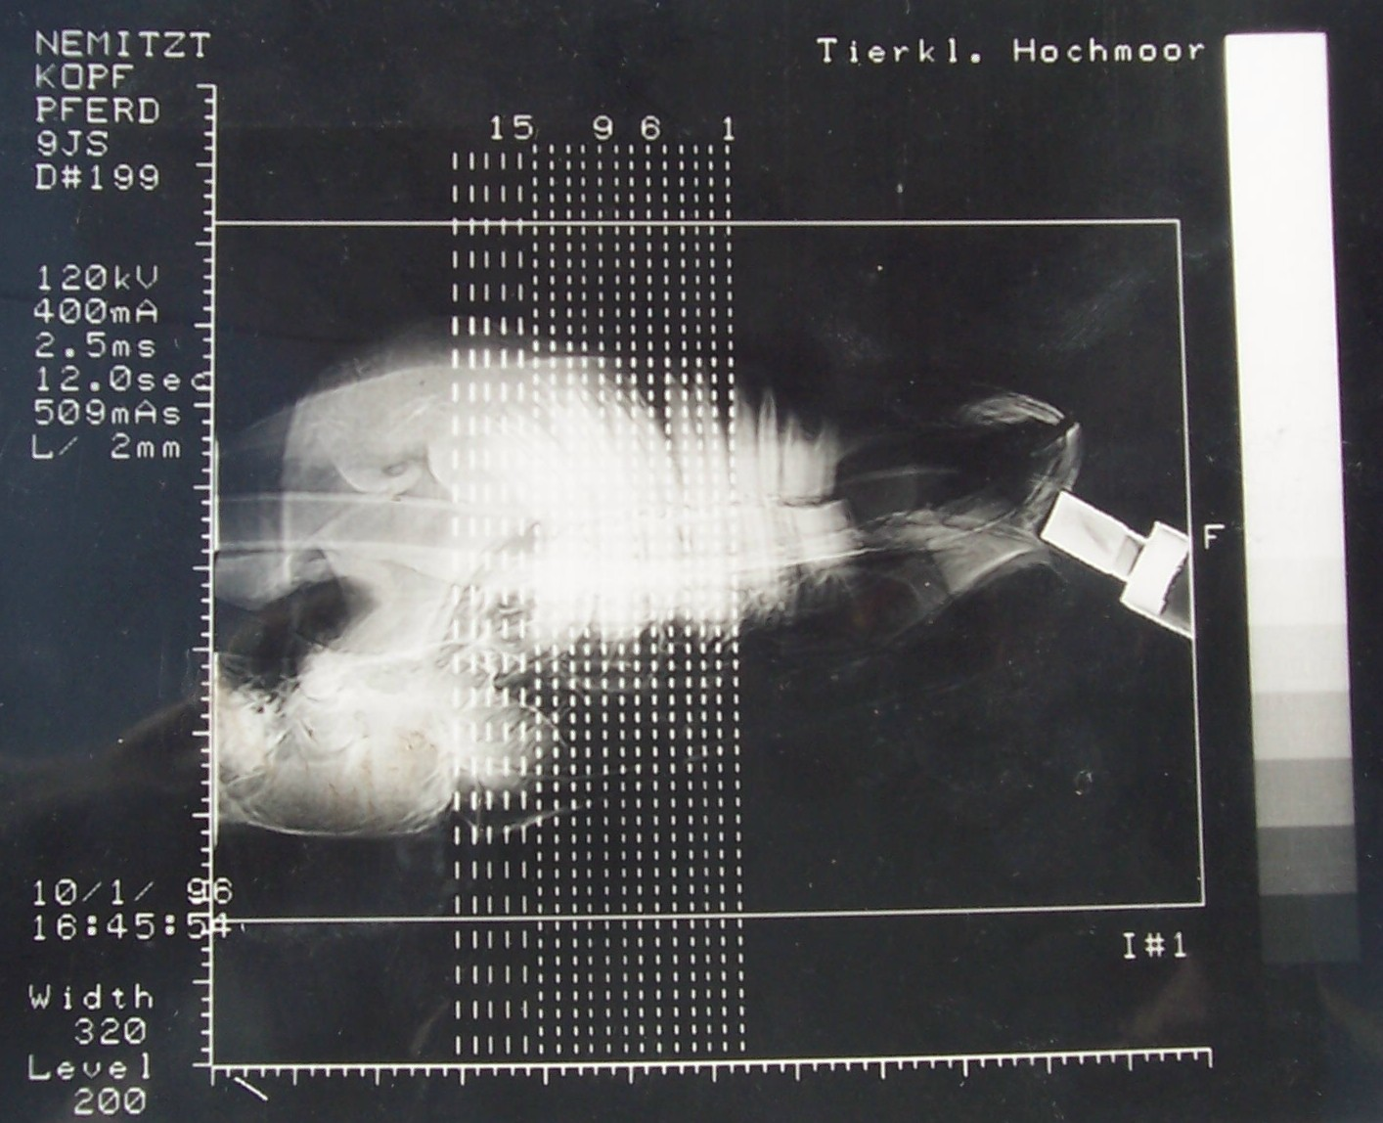
CT Imaging
X-rays are attenuated as they pass through the patient.
The detectors detect the remnant radiation.
Using this information, the computer reconstructs an image.
Each image represents a certain slice thickness of tissue, varying from 2-3 mm to 10 mm, depending on the region imaged and the size of the patient.

Slide 4
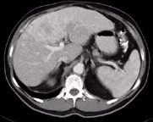
Comparison of CT with conventional X-rays
Ordinary Radiography primarily shows changes in dense bone structures
Specialized techniques like Angiography only depict blood vessels.
CT is able to image a combination of soft tissue, bone, blood vessels, fluid and air spaces.
Different organs and tissues can also be distinguished structurally , (e.g. liver, kidney, spleen), without superimposition.
K
L
S

Slide 5
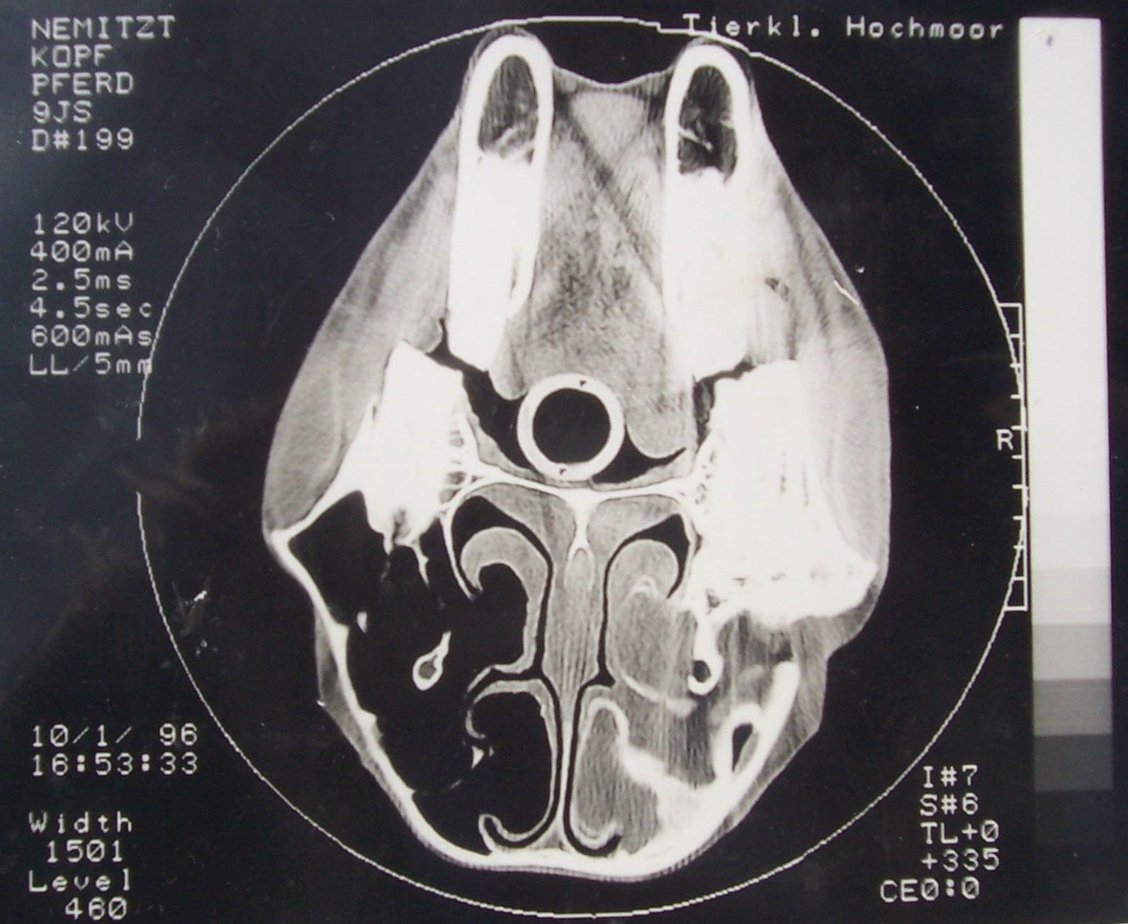
Clinical applications of CT
Head
Cranium – fractures
Brain – tumours, hydrocephalus
Nasal passages & sinuses – rhinitis & sinusitis.
NB: Determining the location and extent of disease processes allows for accurate surgical planning.

Slide 6
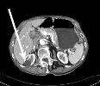
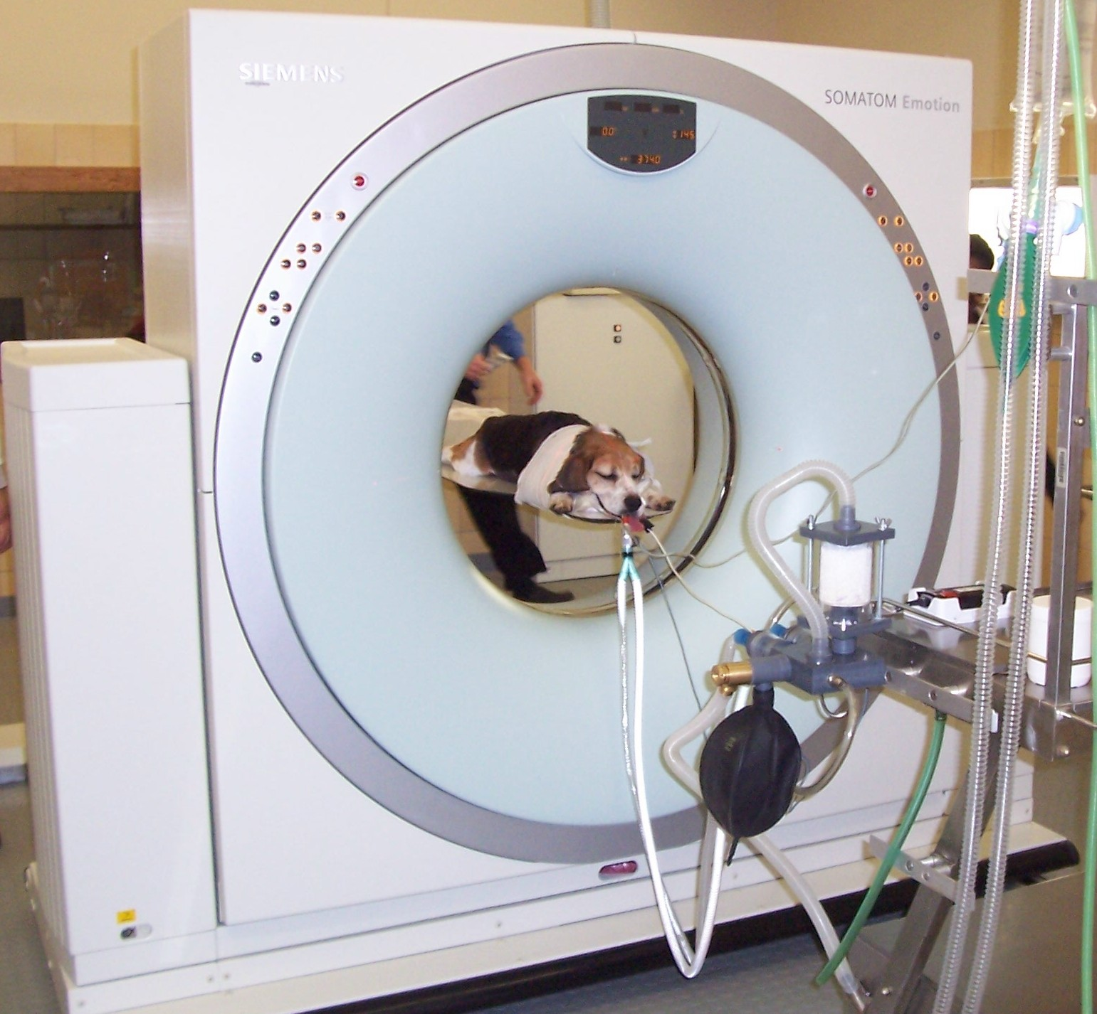
Clinical applications of CT
Thorax and Abdomen
Tumours or other masses
Kidney - cysts
CT image of the abdomen shows a benign (non-cancerous) cyst in the right kidney (arrow)

Slide 7
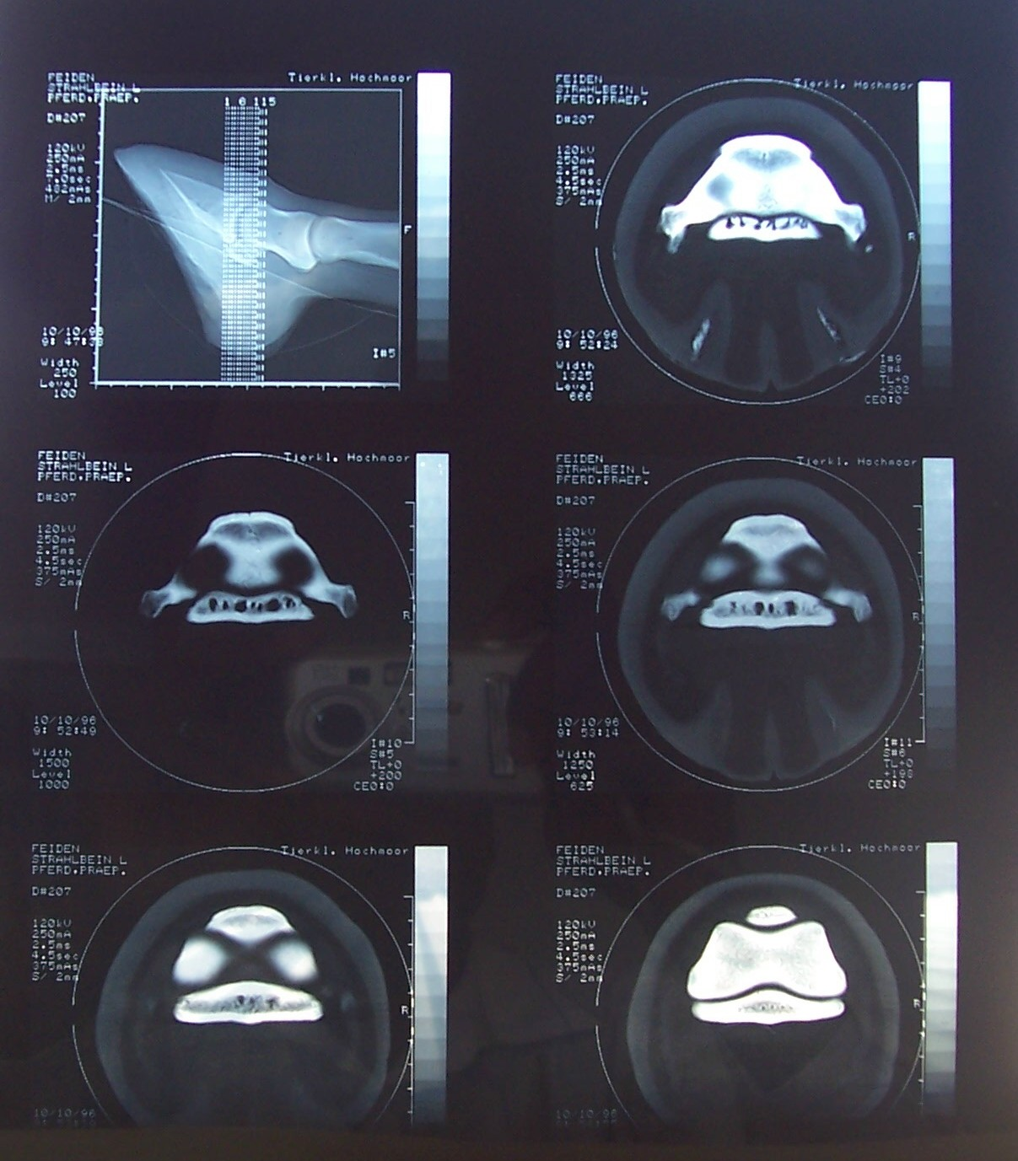
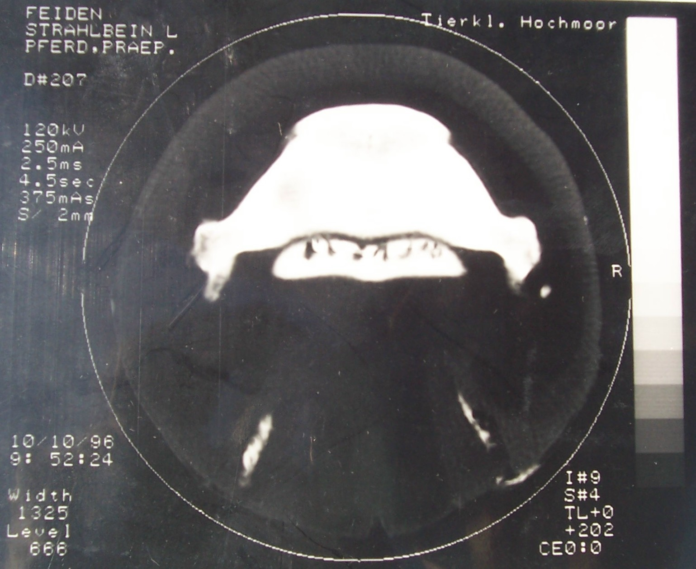
Clinical applications of CT
Limbs and joints
Navicular disease – vascular foramina.
Osteochodritis dissecans, especially if difficult to see on radiographs

Slide 8
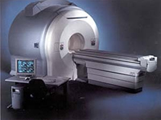
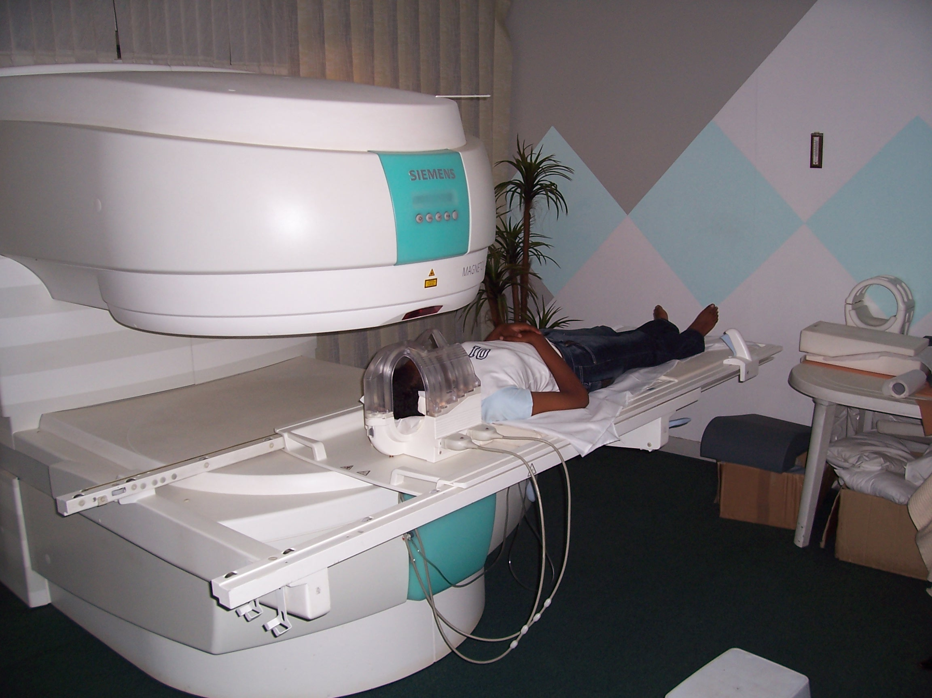
Magnetic Resonance Imaging
Definition
Early MRI machine
Modern MRI machine

Slide 9
Components of MRI:
  The main magnet
  – Superconducting type commonest.
  3 gradient magnets.
  Radio frequency pulse transmission

Slide 10
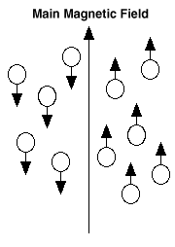
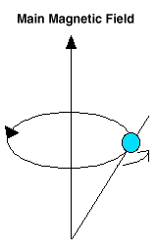
How MRI technology works:
All of the hydrogen protons will align with the magnetic field in the same or opposite direction.
  The hydrogen atom.
  Radio frequency (RF) pulse and “Resonance”.
  Fourier transform and “Imaging”
A hydrogen atom subjected to a RF pulse spins about a magnetic field, also called precession or resonance.

Slide 11
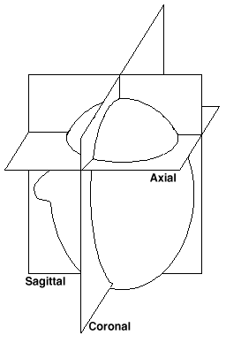
Advantage of MRI in comparison with CT:
MRI can image in the axial (cross-sectional), sagittal (longitudinal) and coronal planes.
CT can only image in the axial plane.
More information with regard to the exact location of a lesion obtained with MRI.

Slide 12
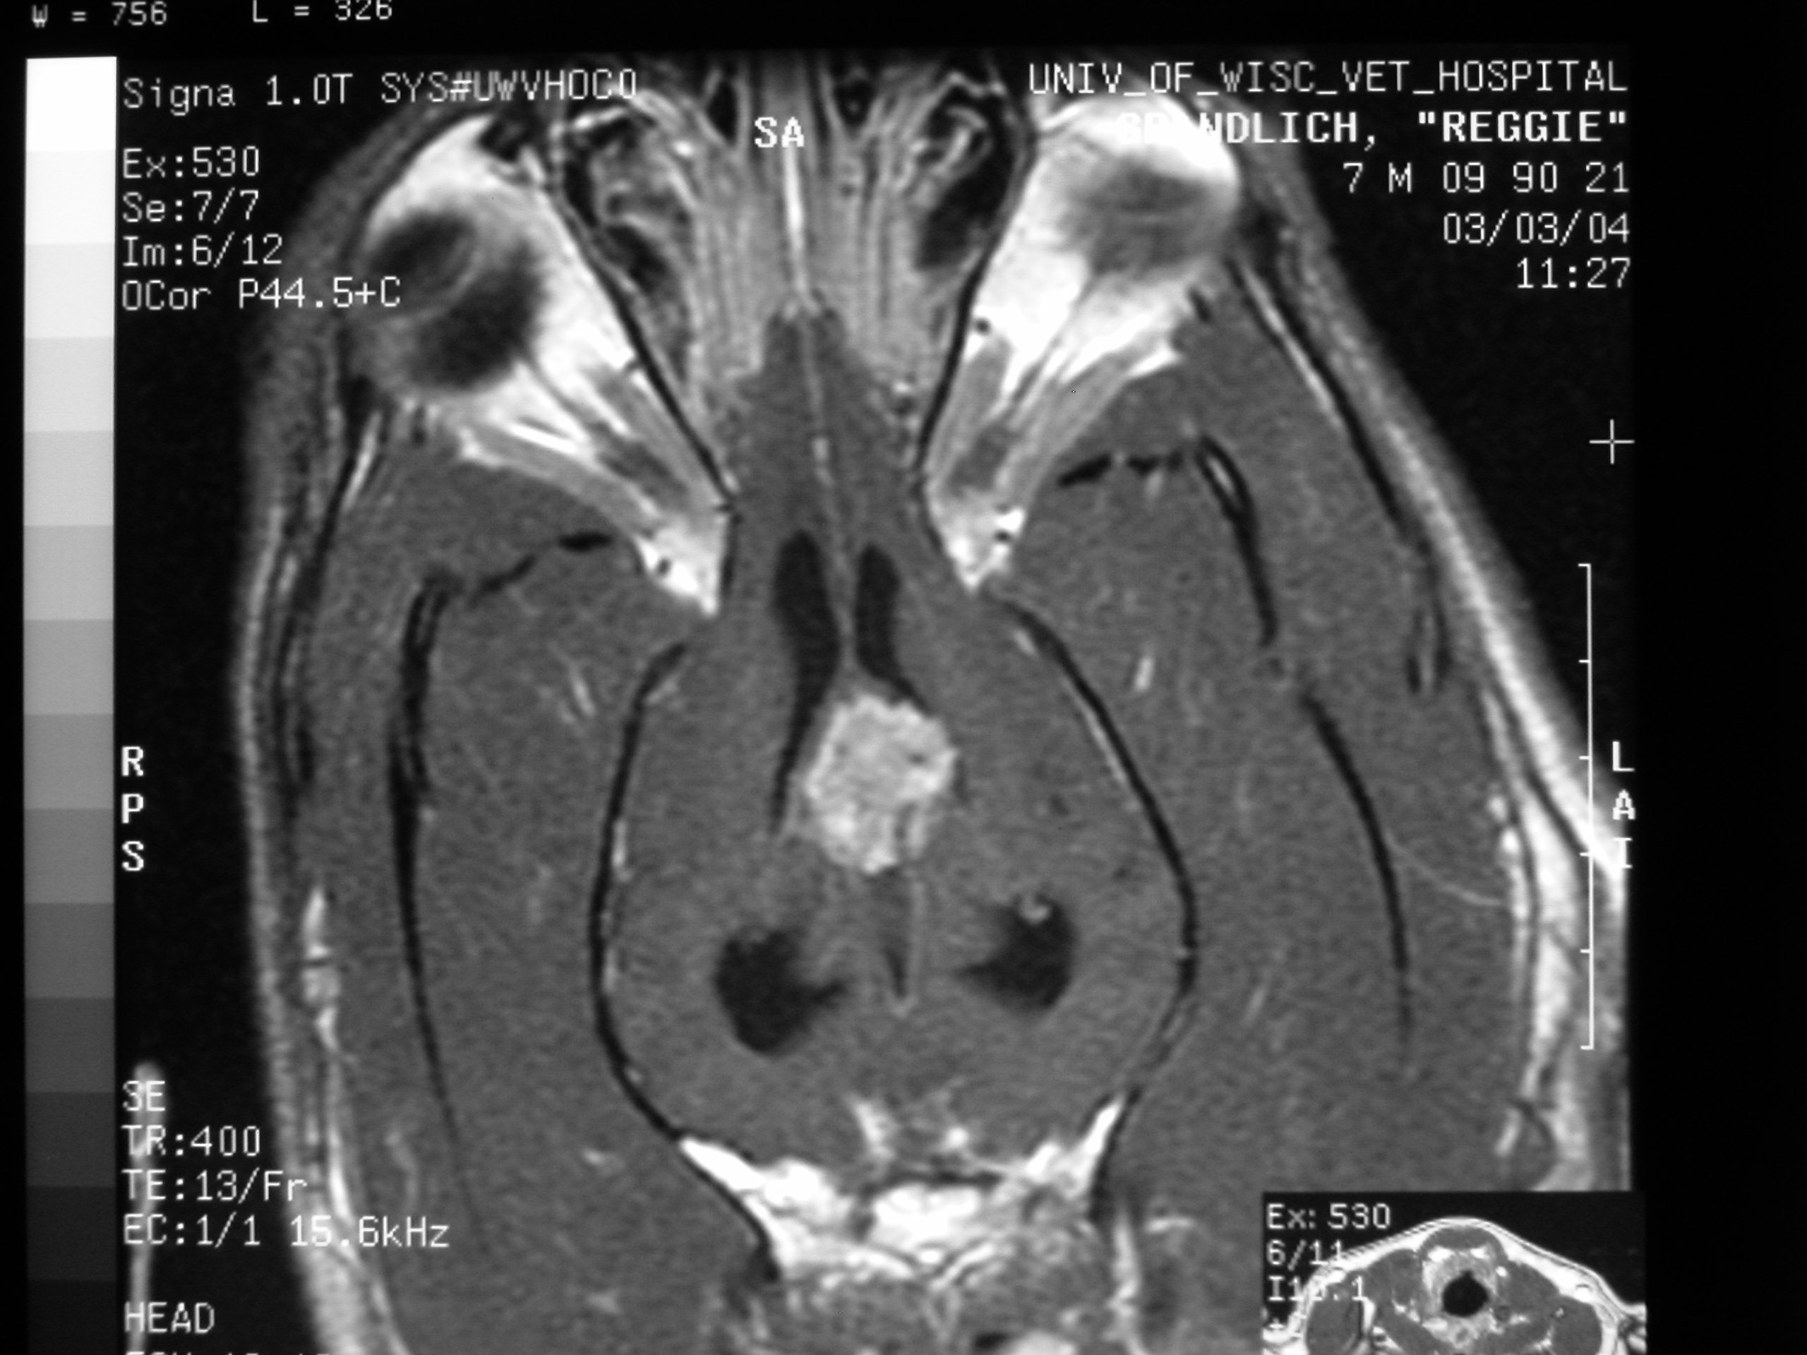
Clinical applications of MRI
a) Head
MRI is ideal for CNS imaging and superior to CT for brain imaging.
Brain lesions detected include congenital lesions (hydrocephalus), infarcts and neoplasia (e.g. choroid plexus papillomas)
- Ocular imaging important too.
Choroid Plexus tumor

Slide 13
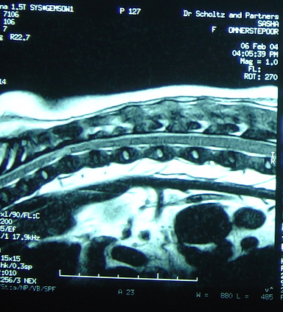
Clinical applications of MRI
b) Spine
Assessment done of intervertebral discs (degeneration and prolapse) intramedullary lesions and lumbosacral disease (e.g. cauda equina compression).
A sagittal image allows the length of the spinal cord to be seen which makes diagnosis easier.
Disc prolapse

Slide 14
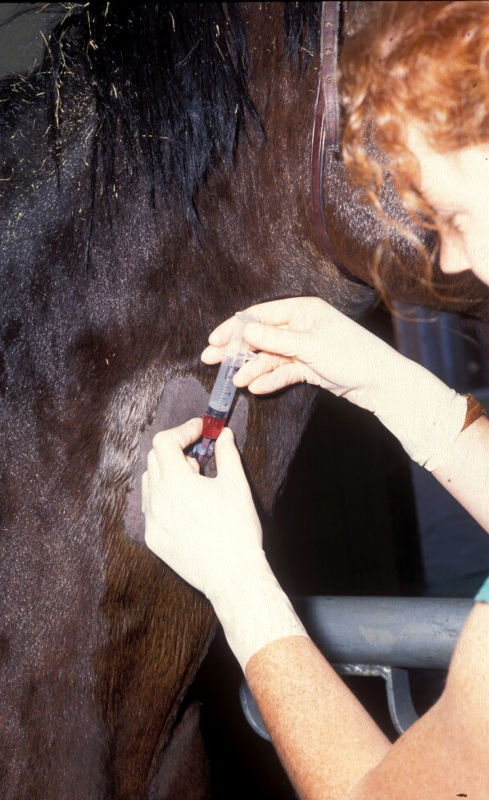
Scintigraphy
This has a different view of body organs than Radiography or Ultrasonography.
Creation of the image relies on the function rather than the anatomy of an organ.
It relies on the intravenous injection of a radioactive substance (radionuclide), which is linked to an organ specific marker (radiopharmaceutical).
The two localise in a targeted organ. The rate or degree of uptake is dependent on the activity (e.g. inflammation) in that organ.

Slide 15
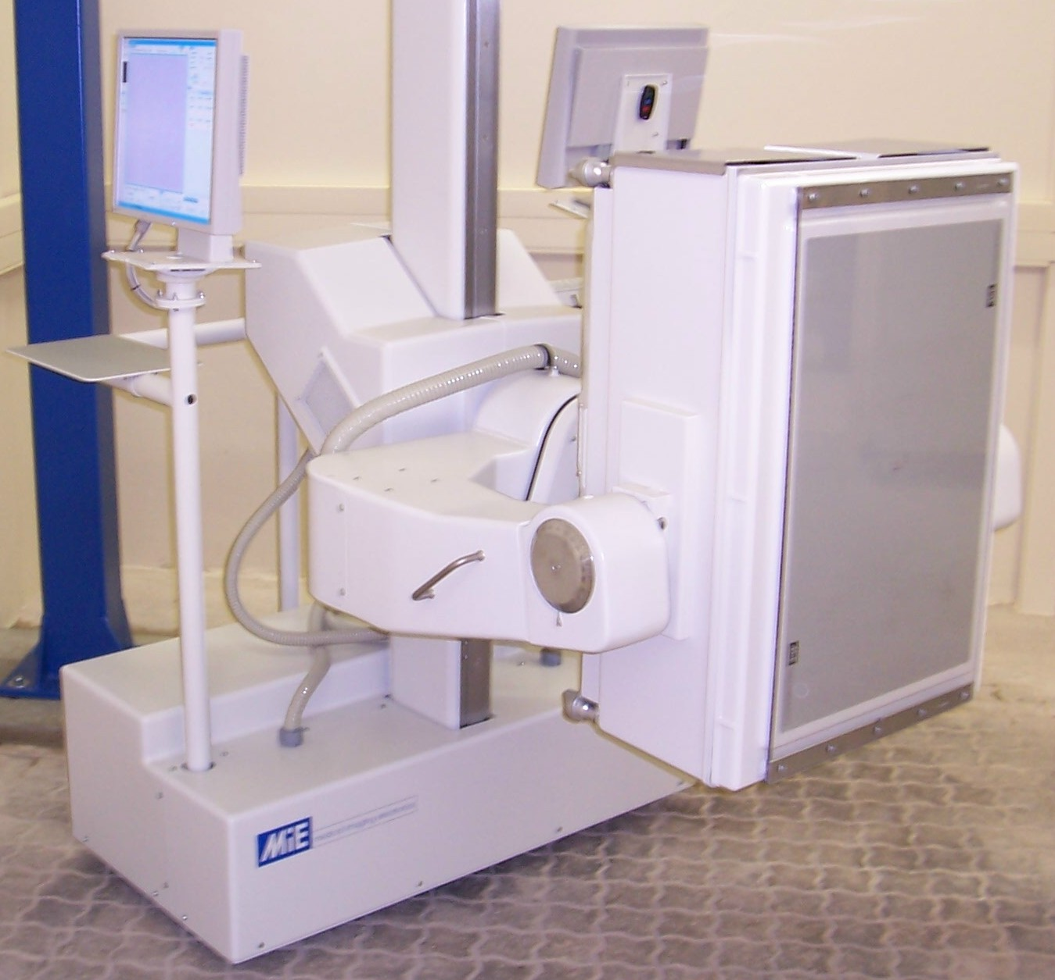
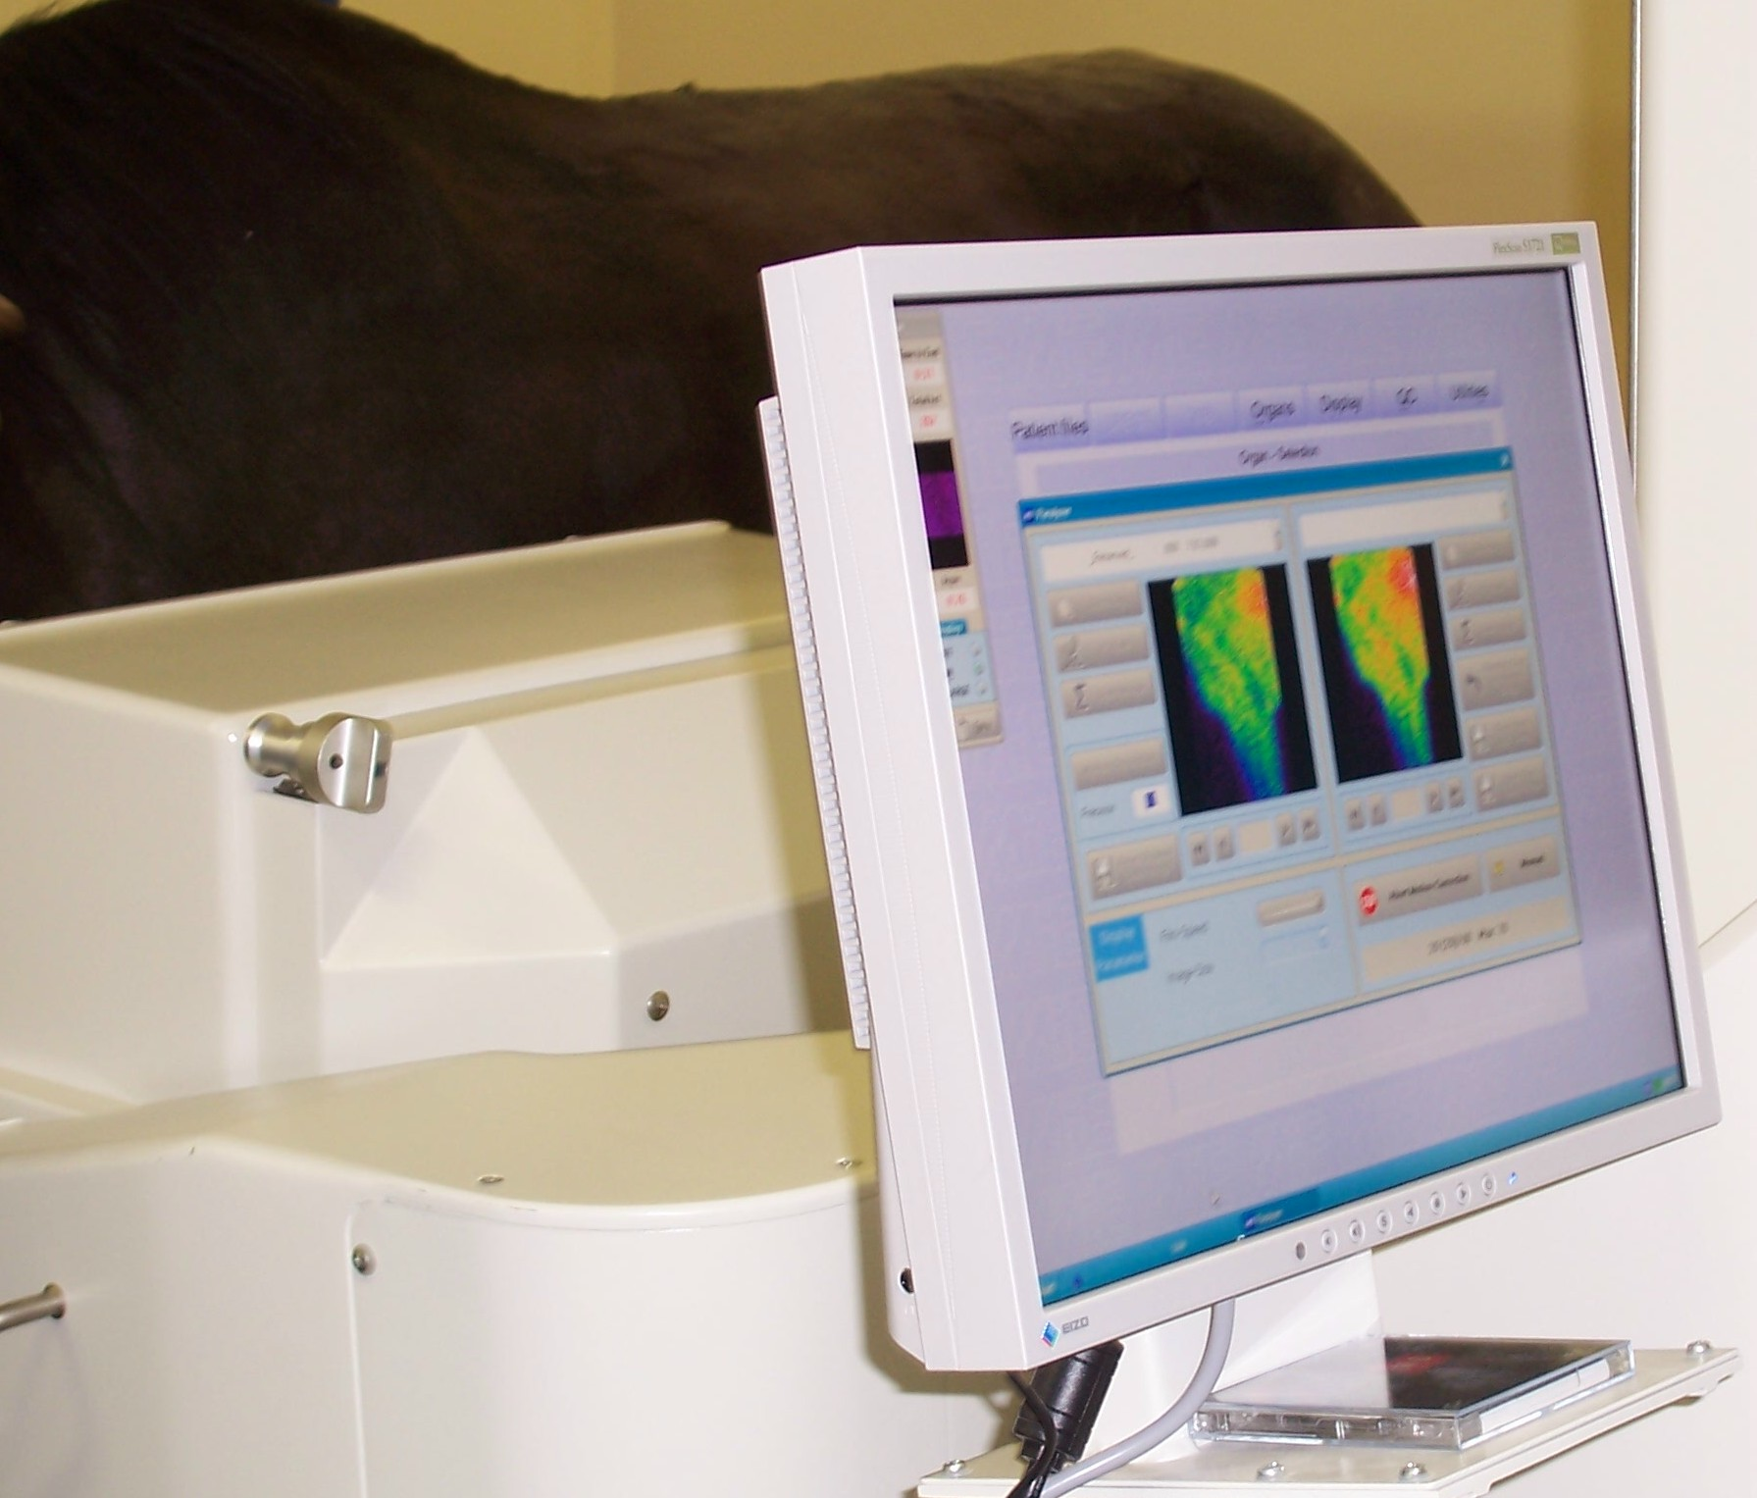
- The Radionuclide used most commonly in veterinary nuclear medicine is Technetium (^{99m}Tc).
- In the body it undergoes radioactive decay and emits radiation in the form of gamma rays.
These gamma rays are detected outside the body using a gamma camera.
This machine contains a crystal which converts gamma rays to light to form the image.

Slide 16
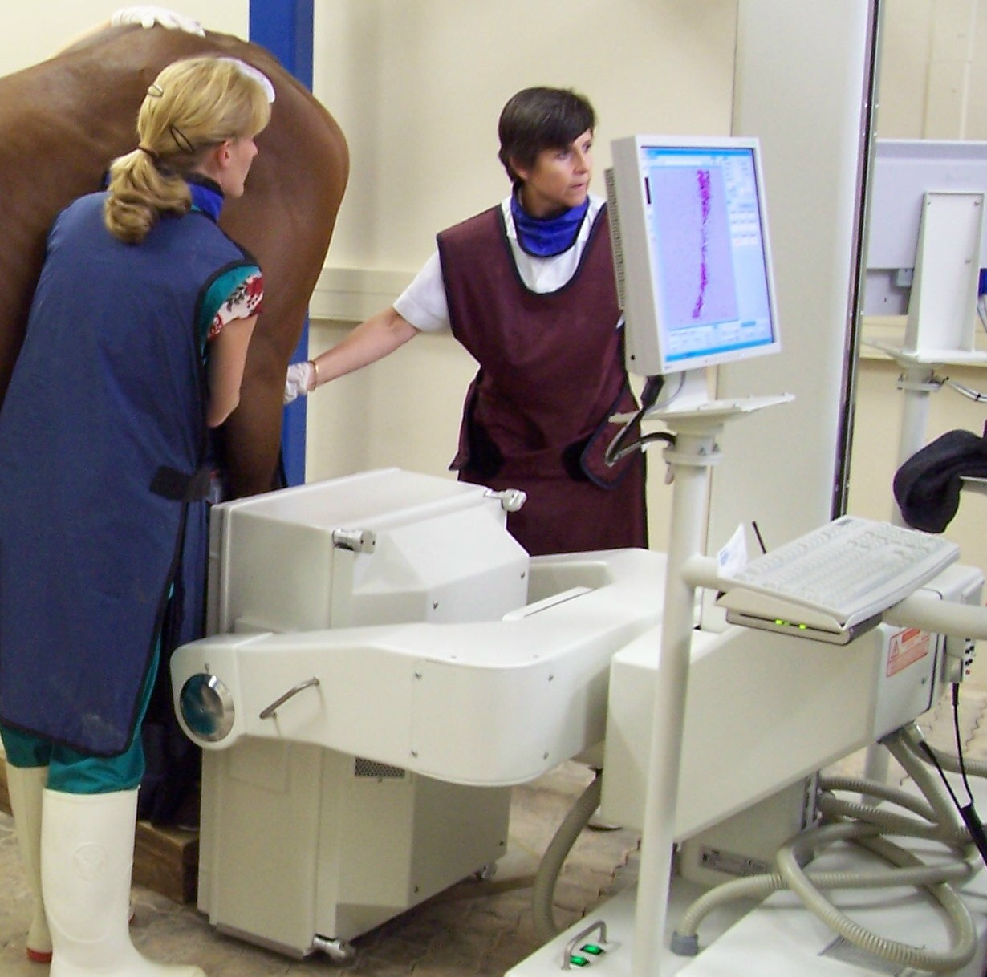
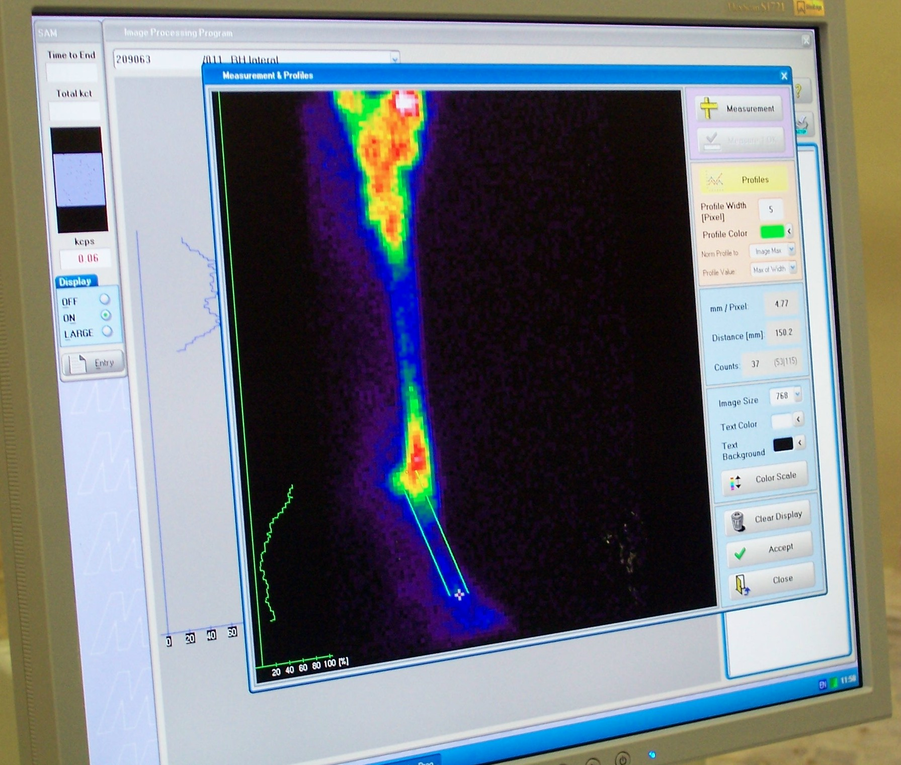
Most clinical Scintigraphy involves evaluation of the skeletal system.
The Technetium is linked to a radiopharmaceutical marker, e.g. Hydroxymethylene diphosphonate (HDP), which is specific for and localises in bones.
The metabolism of the bone is then assessed.

Slide 17
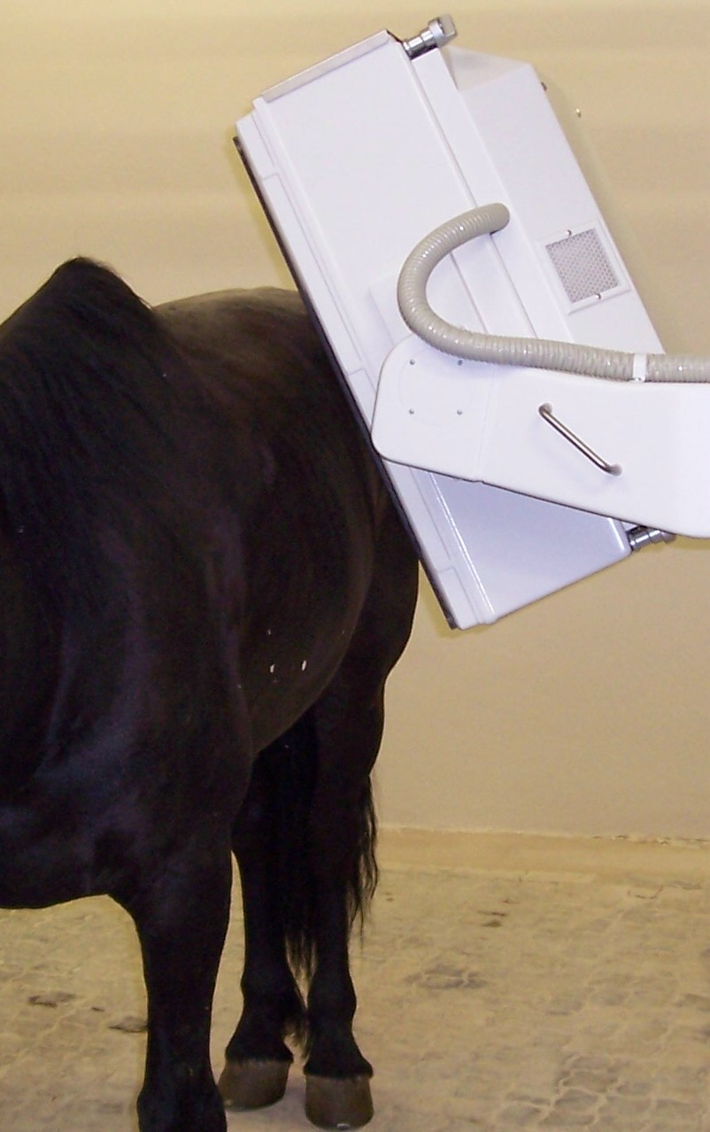
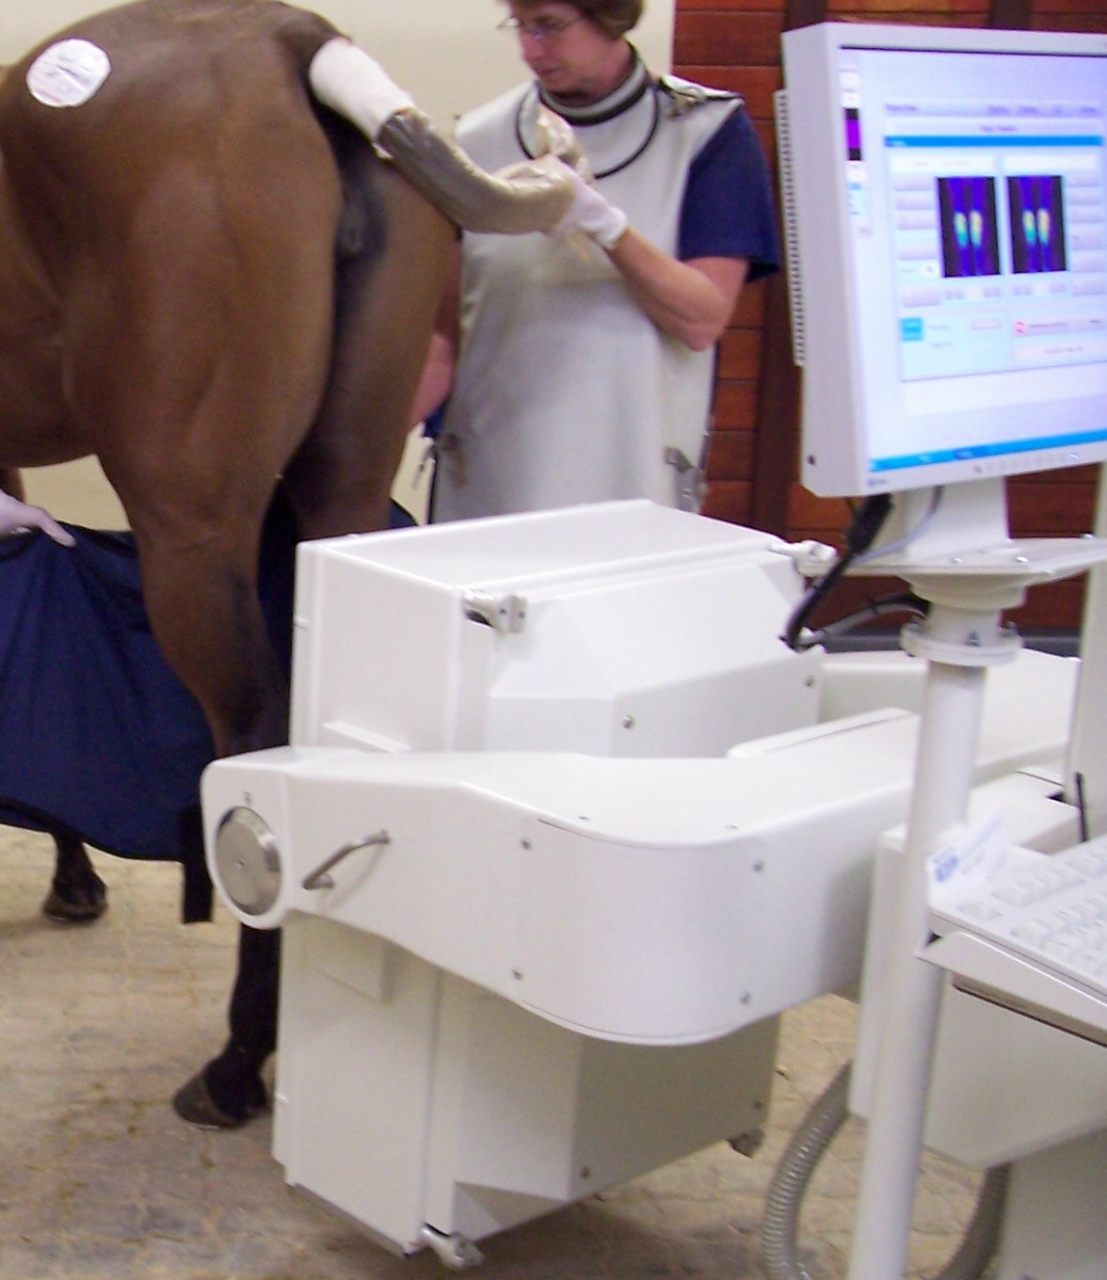
Use of Scintigraphy
The main use in large animals (especially horses) is examination for lameness or poor performance in cases of:-
Suspected stress fractures.
Multi-limb or intermittent lameness.
Back or pelvic problems

Slide 18
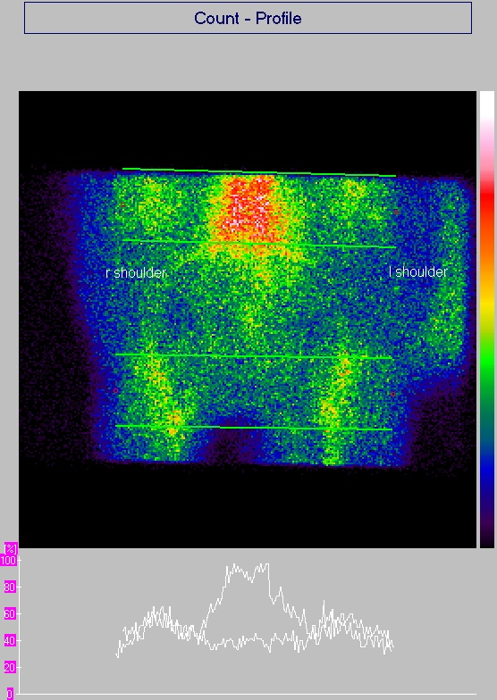
Image interpretation
Sternum
Anterior-posterior Scintigraphy - soft tissue scan of shoulders of horse
Radiopharmaceutical uptake and profiles of the shoulders. The right shoulder has a slightly higher and broader profile peak and “hot spot” that corresponds to the muscle rupture in US slides below.
Rt sh.
Left sh.

Slide 19
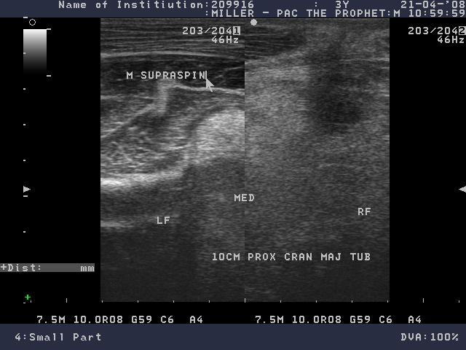
Normal
Ruptured
Ultrasound comparison of the left (normal) and right (ruptured) Supraspinatous muscles in previous horse

Slide 20
Conclusion
Scintigraphy detects changes in function (e.g. inflammation) which can be manifested before radiographic changes are seen, e.g. in stress fractures.
- Scintigraphy should be used together with other imaging techniques (e.g. Ultrasound for soft tissue injuries) to confirm the cause of lameness.

